Slide 1
Horseracing Sector Research –
Traditional Horseracing Baseline Study & Economic Impact of Traditional Horseracing and Thoroughbred Horseracing Sectors on the KwaZulu-Natal Economy
Moses Kotane Institute
4 April 2024

Slide 2
Outline
Moses Kotane Institute (MKI) overview
MKI horseracing sector research
Research outcomes:
  Phase 1: THR baseline study
  Phase 2: Economic Impact of Thoroughbred and THR sectors in KZN
Recommendations

Slide 3
MKI overview
MKI is an entity of the KZN Economic Development, Tourism and Environmental Affairs Department
Mandate
  To conduct world class research into training, skills development, provincial strategic economic sectors; and to strategically lead on innovation, technology, maritime and implementation activities that respond to the needs of the provincial economy.
Research focus areas
  Research focus areas are on the priority economic sectors (i.e., Tourism, Maritime, Manufacturing, ICT, etc.), including emerging industries such as the traditional horseracing.

Slide 4
MKI research – Horseracing sector
The main aim was to inform the development of a Masterplan for the Traditional Equine Industry.
The research was conducted in two phases:
Phase 1: THR baseline study (2021 – 2022)
  Aim: to advise the KZNGBB of the current status, and the requirements and implications of regulating the THR sector in KZN.
Phase 2: Economic Impact of Thoroughbred and THR sectors in KZN (2023)
  Purpose: to provide a comprehensive evaluation of the economic contribution of the horseracing industry to the KZN economy.

Slide 5
Phase 1: THR baseline study

Slide 6
Introduction – THR Baseline Study
Aim: to advise the KZN Gaming and Betting Board of the current status, and the requirements and implications of regulating the rural horse-riding sector in KZN
Scope: The study was limited to the traditional horseracing sector in the Province.
Methodology: combination of desktop research, surveys and face-to-face interviews with key stakeholders and those associated with the sector.
Output: Research report on the KZN THR sector, and Database (Horse owners and jockeys).

Slide 7
Survey results – THR Baseline Study (1)
Demographic profile – Horse owners
Level of education – Horse owners
 | Gender |  | Race
District Municipality | Female | Male | Black/ African | White
Amajuba | 2 | 34 | 36 | -
eThekwini Metropolitan | 1 | 16 | 17 | -
Harry Gwala | - | 36 | 36 | -
iLembe | - | 3 | 3 | -
King Cetshwayo | - | 15 | 15 | -
Ugu | - | 19 | 19 | -
Umgungundlovu | 1 | 31 | 31 | 1
Umkhanyakude | 3 | 11 | 14 | -
uMzinyathi | 2 | 30 | 31 | 1
uThukela | - | 10 | 10 | -
Zululand | 1 | 8 | 9 | -
Total | 10 | 213 | 221 | 2

Slide 8
Survey results – THR Baseline Study (2)

Slide 9
THR Industry value chain stages – high level
Horse production
Horse owners
Horse breeding enterprise/farm
Horse grooms and farriers / Trainers
Horse racing
Jockeys
Veterinarian
Government/Entities/ Municipalities
Industry association (e.g. KZN Rural Horse Riding Association, etc.)
Jockeys
Horse owners
Manufacturers
Specialist Retail store owners
Government/Entities/ Municipalities
Industry association (e.g. KZN Rural Horse Riding Association, etc.)
Veterinarian
Betting companies
Tourism/Hospitality industry
Industry association (e.g., KZN Rural Horse Riding Association, etc.)
Sponsors
Patrons and punters
Horse Racecourse Operators/ Facility Managers
Event organizers (i.e., mainly representatives from various municipalities)
Government/Entities/ Municipalities
Regulatory Authority (National Horseracing Authority)
Horse owners
Horse management

Slide 10
Key Findings (2) – THR Value Chain Analysis
Jockeys tend to be born into the THR fraternity home and culture. This suggests that those people not born into the sport are more likely not to participate in the sport as either jockey and/or jockey-horse owners.
Jockeys often do not receive formal training. Instead, they learn by observation, copying their idols, and by receiving coaching from past champion participants.
Jockeys are plying their trade with very little financial support. There are very few sponsorships from the private sector. In contrast, municipalities are providing most of the support.
Financial rewards are very minimal, and they are well below a living wage (no guideline exists).
There are very few facilities available for jockeys. Some jockeys do not have access to basic racing tracks at all and have to create their own practice or exercise areas from unkempt grounds.
The motivation for horse owners is not simply cultural or the need to participate in the THR sport code; instead profit maximization is increasingly playing a role as a motivating factor, and this is an indication that the sport needs to transform and assume a pecuniary grounding.
All the horse owners bought their horses. Noteworthy, none of the horse owners indicated that they bought their horses at an auction. There is no reference to auctions in primary data.

Slide 11
Key Findings (2) – THR Value Chain Analysis…contd.
None of the horse owners participate in the THR as breeders. Instead, horse owners own just a few horses – one to four horses on nominal terms.
Horse owners generally cannot afford to buy correct and requisite horse feed.
There is no specialist training academy for THR.
There is almost no meaningful private sector sponsor any longer, a sign that THR must adopt a strategy that can stimulate financial revenue generation for the sector.
The government is the main sponsor of THR, but its involvement is limited to a few flagship events.
In general terms there is very little financial inflow into THR.
The actual racing regime is managed or conducted according to perception and feel, and there is no proper grading.
Race-winning prizes are varied and mixed, and include both money and consumables, but are in reality are low and often non-existent.

Slide 12
Recommendations – THR baseline study (1)

Slide 13
Recommendations – THR baseline study (2)
Strategic interventions proposed to monetize THR
Supply-side investments (Horse owners & jockeys)
Introduce betting on THR events (there is no official betting on THR events. This must change rapidly. THR has many opportunities per calendar season over weekends for it to derive revenue from betting on horse races regularly, per event – provincial, district, and local races.
Betting infrastructure and requirements for participation (THR needs to possess certain pre-requisites for it to be accepted into the betting fold – i.e., follow the National Horseracing Association (NHRA) regulatory framework)
Implement all NHRA requirements (Correct identification of horses; Horse welfare; Correct race monitoring by de jure officials)
Financial transfers - THR should work out a contractual framework to determine how funds accumulating to THR through mainly betting will be shared amongst horse owners and jockeys.
Infrastructure - Financial revenues into the THR should be invested in constructing racing infrastructure.
Notes:
Betting is the leading strategy for generating revenues for horse racing today. It is a proven method of sustaining horse racing across international equine markets.

Slide 14
Phase 2:
Economic Impact of Thoroughbred and THR sectors in KZN

Slide 15
Introduction – Economic Impact Study
The purpose of this research segment was to provide a comprehensive evaluation of the economic contribution of the horseracing industry to the KZN economy.
Methodology:
The economic impact analysis was conducted using a macroeconomic impact modelling system. The methodology used can be broken down into three main stages:
  Gathering direct and indirect expenditure data from available sources
  Converting expenditure data into industry-specific expenditure to facilitate modelling
  Developing and using input-output models to estimate the wider effects of the industry on the economy as a whole
Notes:
The information gathered from both the survey (Primary Research) and secondary data (Desktop Research) made it possible to undertake a credible economic impact study.

Slide 16
Methodology (continued…)
Economic Impact Assessment
The economic impact assessment of the thoroughbred and traditional horse racing industries used several key metrics and economic indicators, including:
Value added: The contribution of the horse racing industry to the gross domestic product (GDP) of the province.
Employment: The number of people employed in the horse racing industry, including direct and indirect employment.
Labour income: The amount of income earned by those employed in the horse racing industry, including direct and indirect income.
Government Revenue (Taxes): The amount of taxes paid by the horse racing industry to the local, provincial, and national governments.
Rating of racing events: several key metrics and economic indicators such as the amount of capital invested in the industry (capital investment), the total value of goods and services produced (total output), and the impact of the industry on other sectors of the economy (multiplier effects), such as tourism, hospitality, and agriculture.

Slide 17
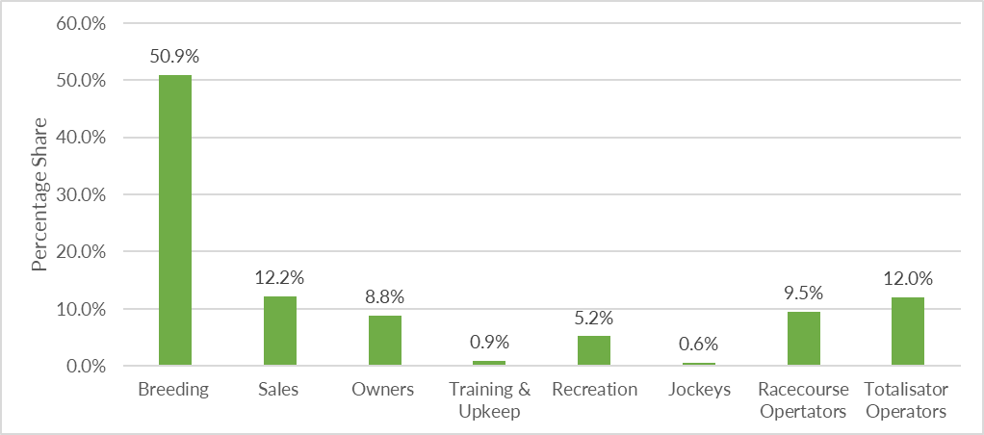
Percentage Share of the Value Chain Components of the KZN Thoroughbred Horse Racing Industry in terms of
Gross Domestic Product (GDP).
Economic Impact Results – Thoroughbred Horse Racing
The percentage share of the backward linkages components of the KZN Thoroughbred Horse Racing Industry is presented in terms of GDP above.
Breeding is clearly a big contributor to GDP which is hugely profitable.

Slide 18
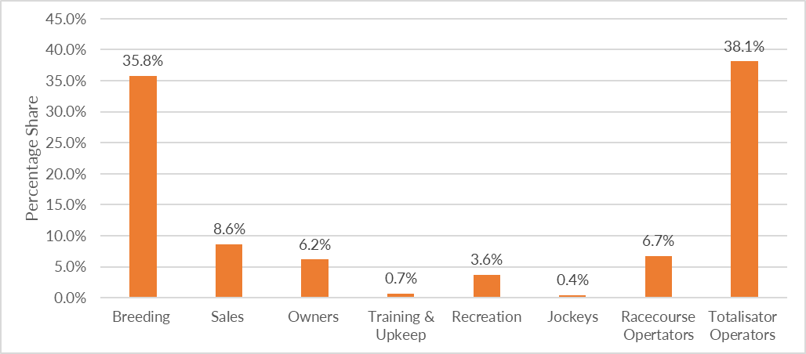
Percentage Share of the Value Chain Components of the KZN Thoroughbred Horse Racing Industry in terms of Employment
Economic Impact Results – Thoroughbred Horse Racing
The percentage share of employment is shown for the different value chain components of the KZN Thoroughbred Horse Racing Industry.
The figure above shows the importance of supporting the top four components of Breeding, Sales, Totalisator Operations and Racecourse operations to boost the Thoroughbred sector.

Slide 19
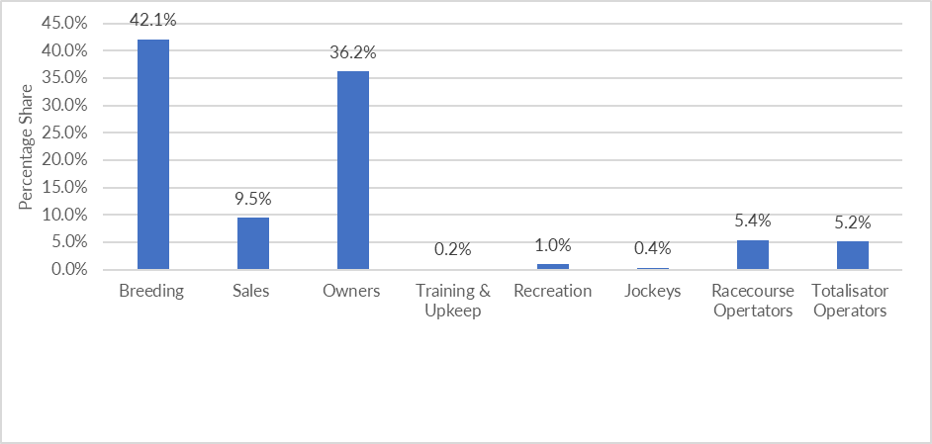
Economic Impact Results – THR (1)
Percentage Share of the Value Chain Components of the KZN THR Industry in terms of GDP.
In the figure above, the percentage share of the different linkage components of the KZN THR Industry is shown in terms of GDP.
Breeding was discovered to be a huge contributor to GDP while being very profitable and needs support of the government.

Slide 20
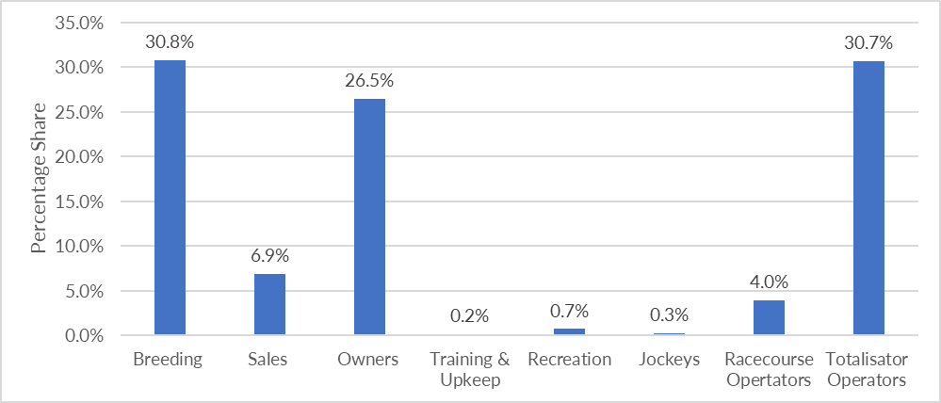
Economic Impact Results – THR (2)
Percentage Share of the Value Chain Components of the KZN THR Industry in terms of Employment.
In the figure above, the percentage share of employment in the different value chain components of the KZN THR Industry is shown. This sector is still very labour intensive. Furthermore, totalisator operations indicate a need for support through operator licenses in this sector.

Slide 21
Key Findings – Economic Impact Study
The macroeconomic performance indicators show that the Thoroughbred Horse Racing Industry has a significant macroeconomic impact on the economy of KZN. The industry contributes an annual GDP of R1 987 Million in constant 2023 prices, provides employment opportunities for approximately 6 296 individuals, and leads to further capital formation of R2 425 Million.
Capital formation refers to the amount of investment dedicated to the project, and in this instance, the direct capital relates to the actual investment channelled to the project.
It creates Household Income of R1 100 Million, of which nearly 38% (R410 Million) is destined for low-income households. It generates a fiscal impact of R411 Million.
In terms of fiscal impact, the Thoroughbred industry is expected to generate direct and indirect tax revenues of R411 million annually.
The macroeconomic performance indicators show that the total THR Industry has a reasonable macroeconomic impact on the economy of the Project Focus Area (i.e. KZN). The industry contributes an annual GDP of R81 Million in constant 2023 prices, provides employment opportunities for approximately 372 individuals, and leads to further capital formation of R160 Million.
It creates Household Income of R48 Million, of which nearly 41.7% (R410 Million) is destined for low-income households. It generates fiscal impact of R17 Million.
In terms of fiscal impact, direct and indirect tax revenues are expected to reach R17 million annually for the traditional horseracing sector.

Slide 22
Recommendations – Economic Impact Study (1)
This analysis highlights the implications of industry growth and development. Efforts to support the industry (financial, marketing, technical, capital, infrastructure, veterinary, environmental compliance, etc.) especially the THR Industry will have broader impacts on the KZN’s economy as well as in the regional economies where traditional horse racing is prominent and widely practiced.
Marketing strategies, targeting specific demographics like Black Africans and the Youth, should be implemented to promote ownership through horseracing syndicates.
This analysis found that horse owners, breeders, and trainers already invest fair amounts of money in KZN in terms of both Traditional and Thoroughbred Horse Racing Industries. Adding additional horses will increase economic activity. For an increase in the number of horses to occur, the economics and financials need to support breeder and owner investment in breeding and raising horses until they are old enough to race especially for the THR Industry.
Racing events like the Dundee July, Harry Gwala Summer Cup and Willowfontein Race Day have become popular events attracting a growing number of people year on year. Some of the gaming operators already involved in THR should remain as this is an activity which enjoys a broader, working class, ownership profile. This strategy together with the promotion of syndicates can lead to increased participation in this industry.
The THR industry continues to be a significant contributor to a broad range of both rural and urban regions of KZN, playing an important role in the viability of rural communities. It is strongly connected to its agricultural base, strongly benefiting rural areas (85% of the total economic impact of horse racing) as well as urban areas (15% of the total impact). Hence it is important to factor this industry in the local rural development strategies as well as local economic development strategies of relevant local municipalities.

Slide 23
Recommendations – Economic Impact Study (2)
Marketing strategies and tools currently used by the organizers of THR events are sub-optimal to attract a critical mass of spectators and participants to this event. An effective combination of both traditional and digital marketing communication tools is relevant to this event.
There is a need for the government to be more proactive in encouraging the youth to participate in THR Industry. Measures such as more conducive policies for contractual arrangements can serve as an incentive for encouraging increased participation.
Therefore, there is a further need to collect quantitative data from current and prospective attendees of THR events and continue updating the electronic database created to capture pertinent data pertaining to Traditional Horse Racing Industry (Especially Value Chain Components of this industry). The database must be updated at regular intervals.
The economic impact study needs also be updated at certain intervals (after a cycle of 3 years) to keep track and have the most recent economic impacts.

Slide 24
THANK YOU

